Slide 1

AI Project (AI101B)
Even Semester Session 2024-25
Object Detection In Images
Ansh Mishra (202410116100030)
Abhishek Sharma(202410116100009)
Ankit Sisodia (202410116100029)
Ashutosh Singh(202410116100043)
Project Supervisor:
Mr.Apoorv Jain
Asst.Professor

Slide 2
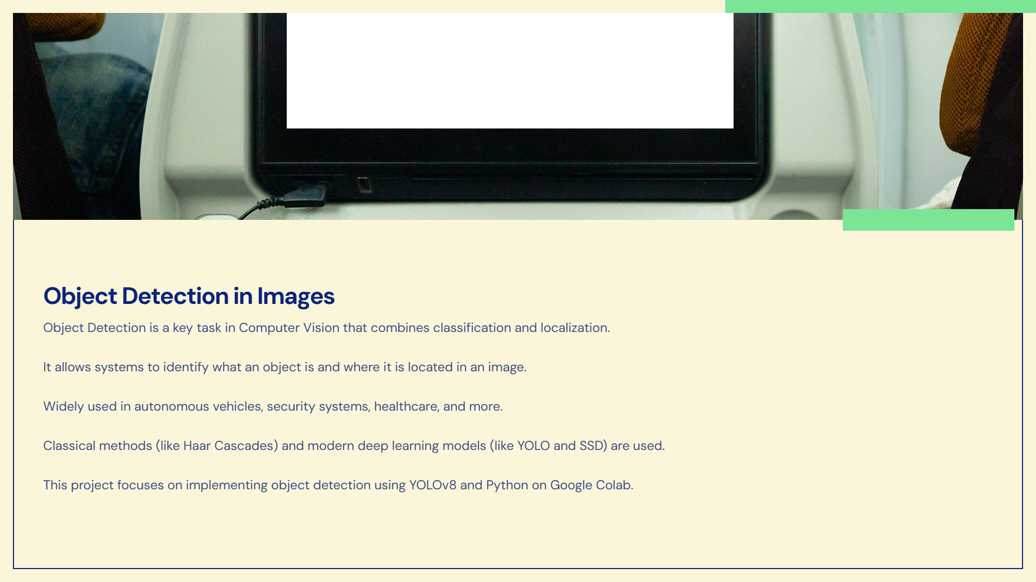


Slide 3
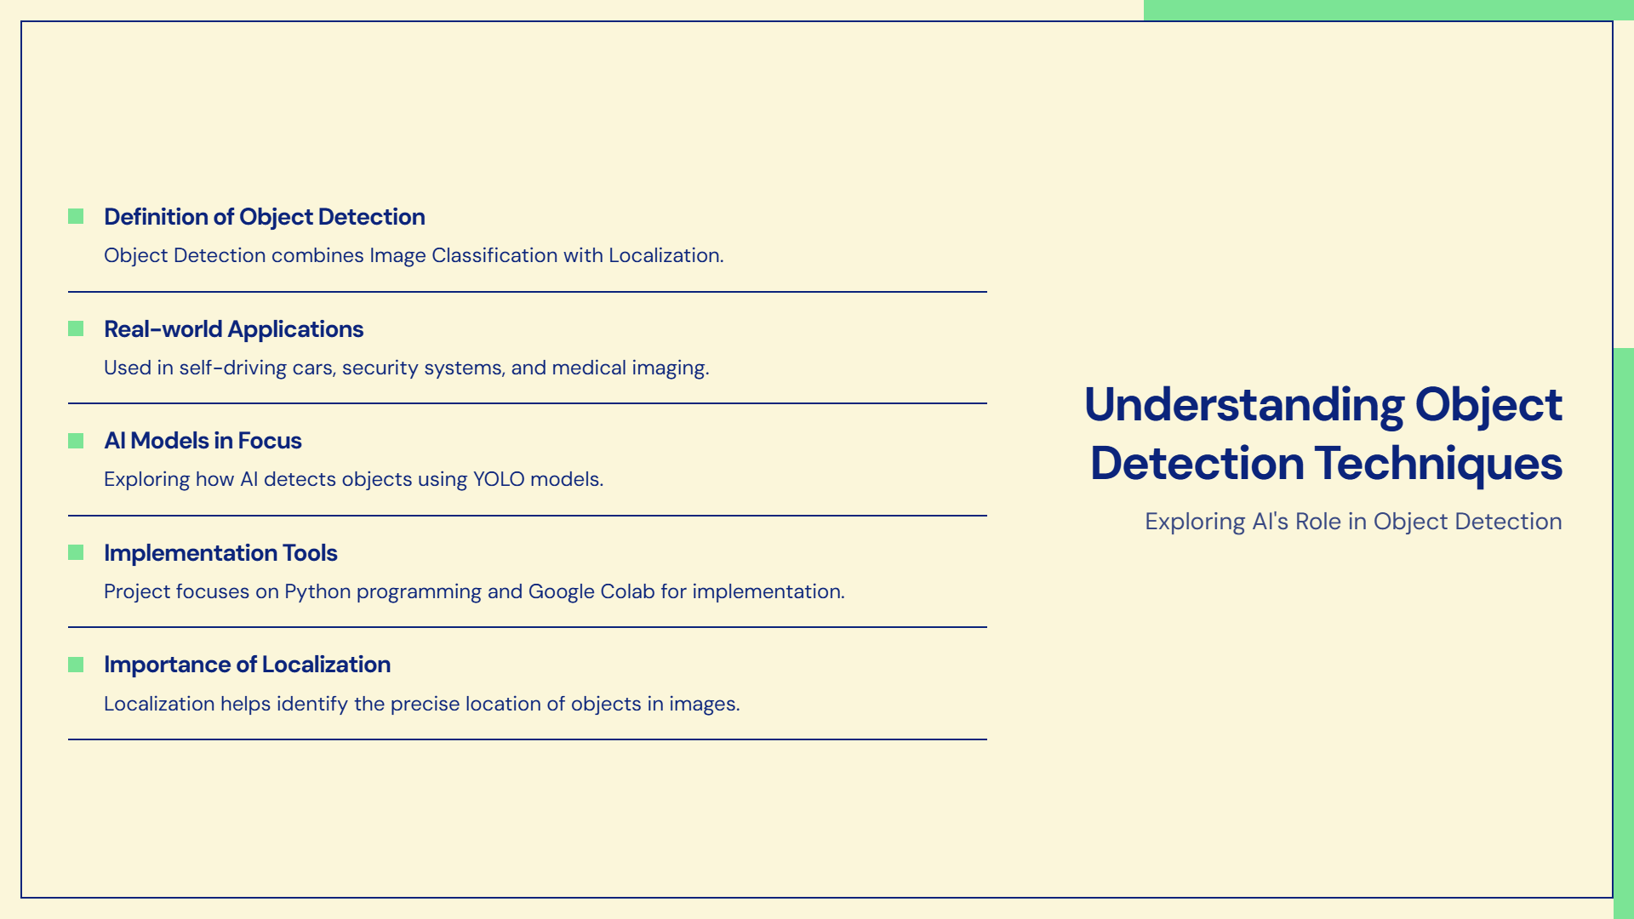

Slide 4
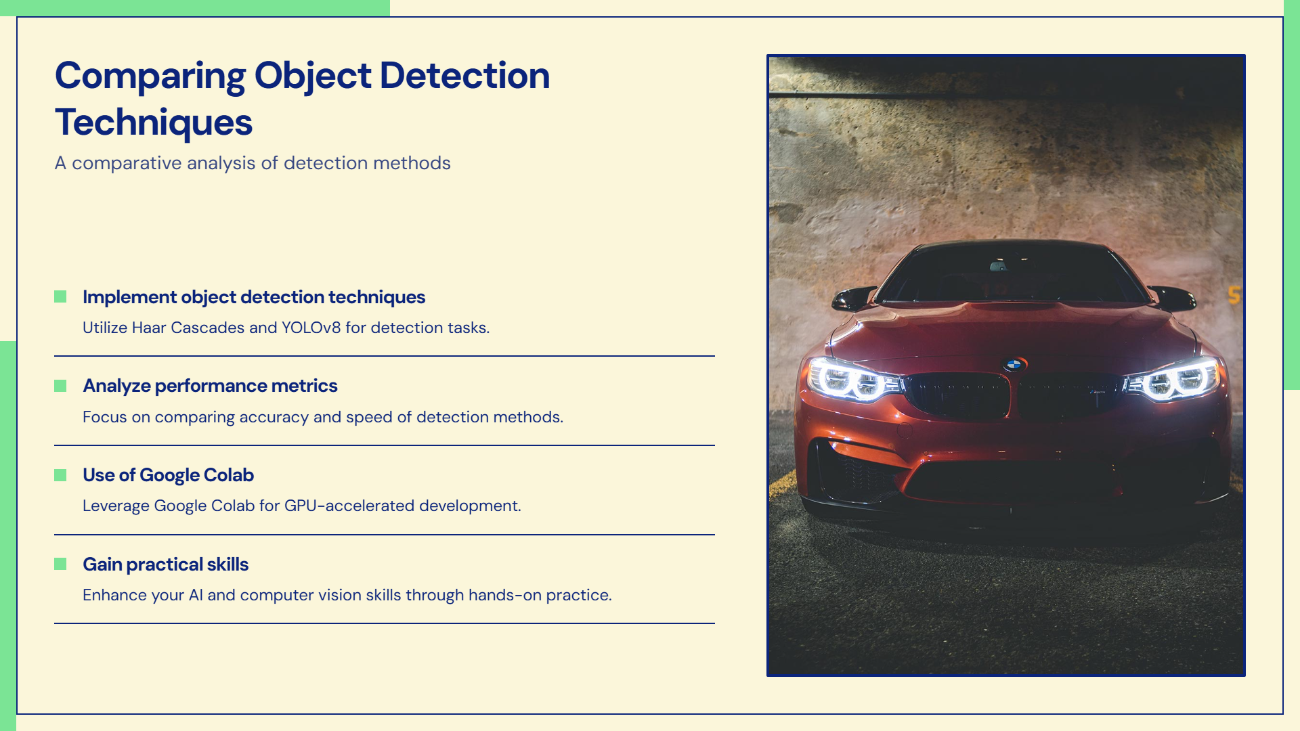

Slide 5
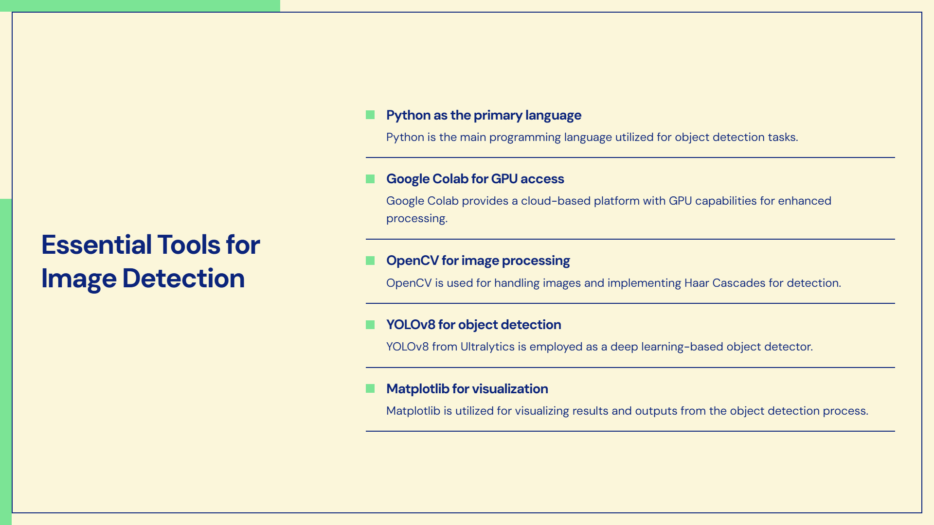

Slide 6
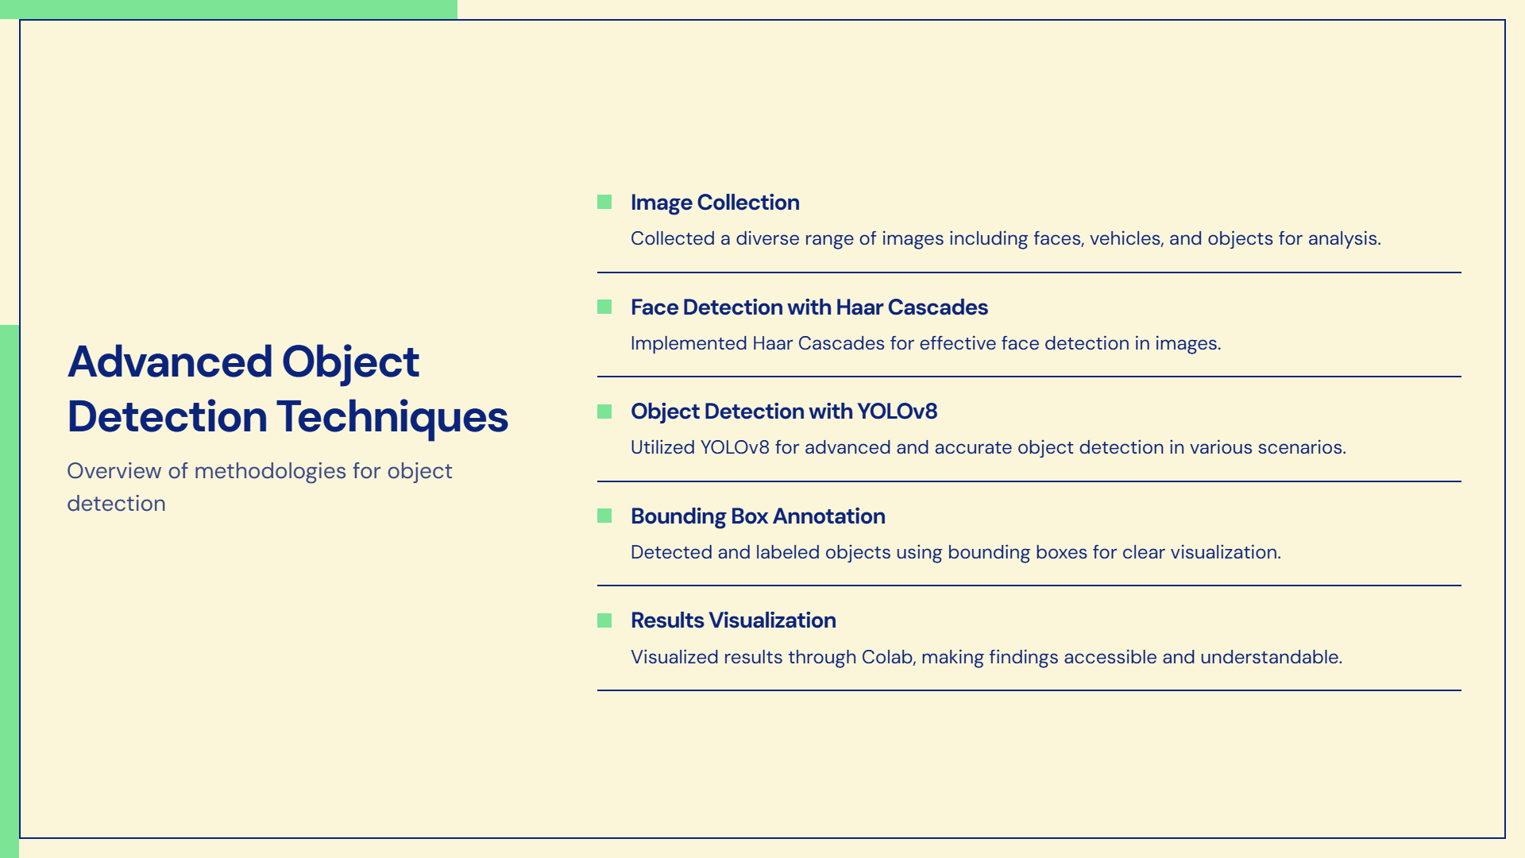

Slide 7
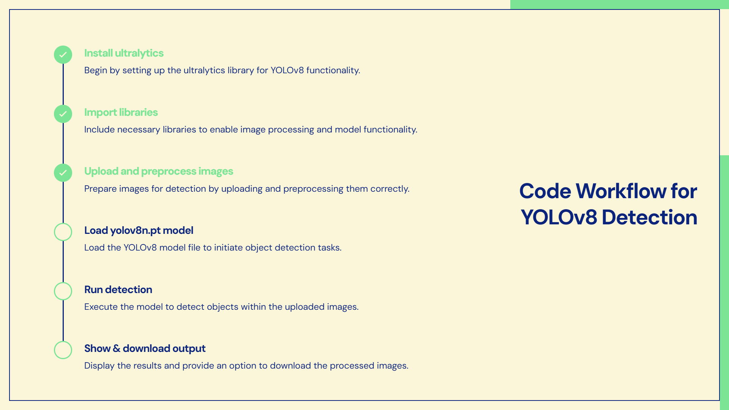

Slide 8
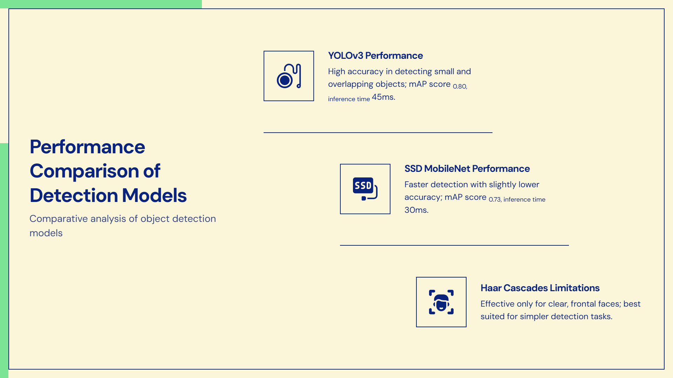

Slide 9
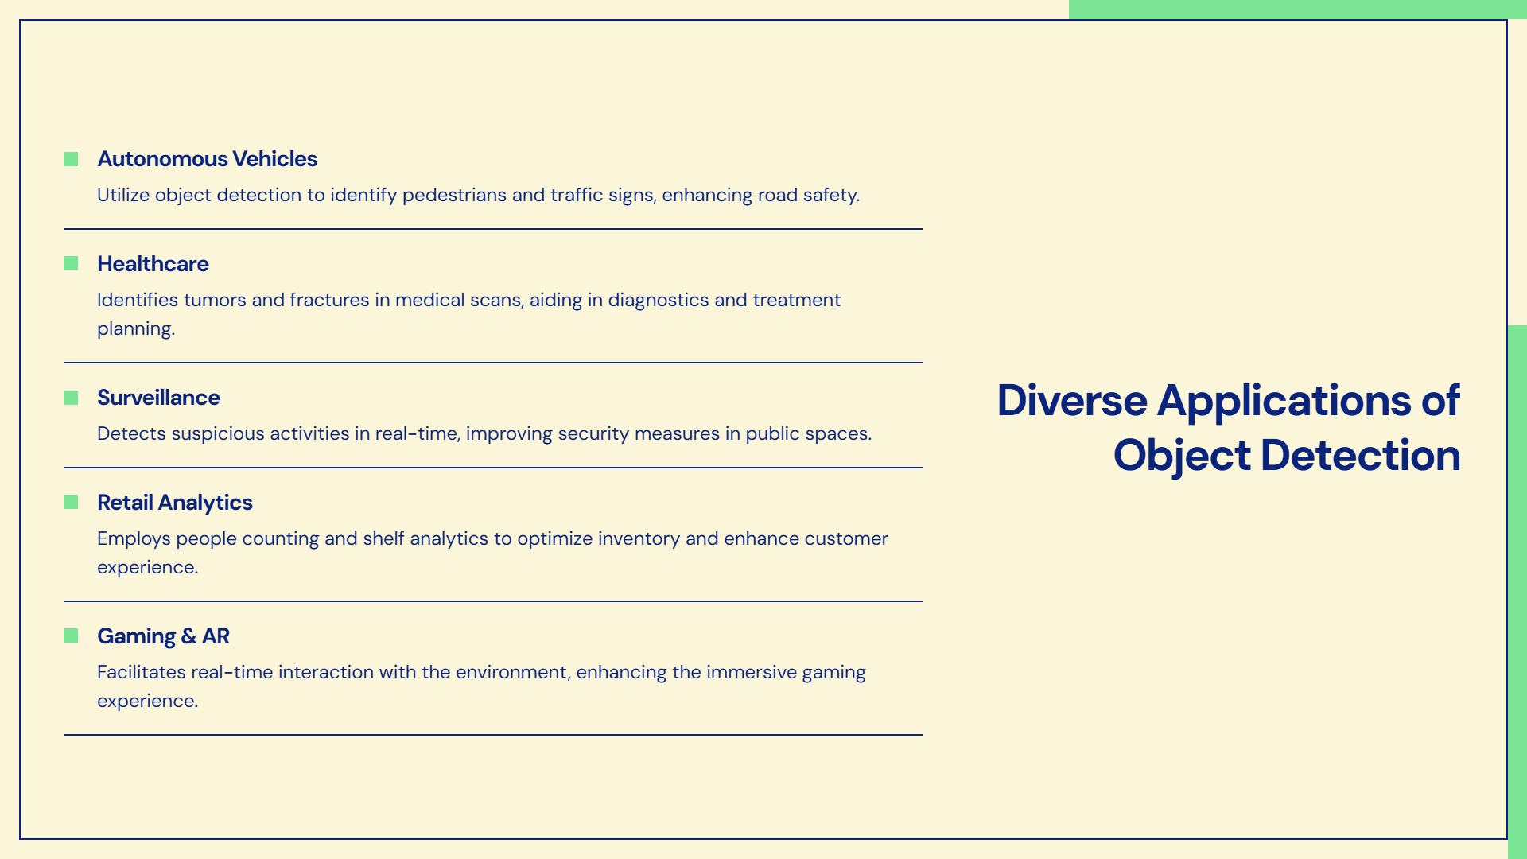

Slide 10
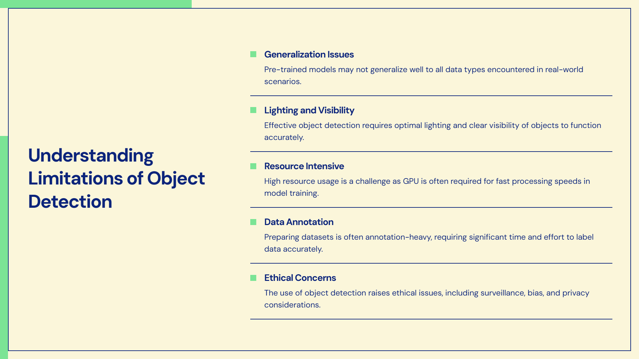

Slide 11
